Slide 1
Car CASE STUDY
By poonam kocheta

Slide 2
Feature description

Slide 3

Data visualization

Slide 4
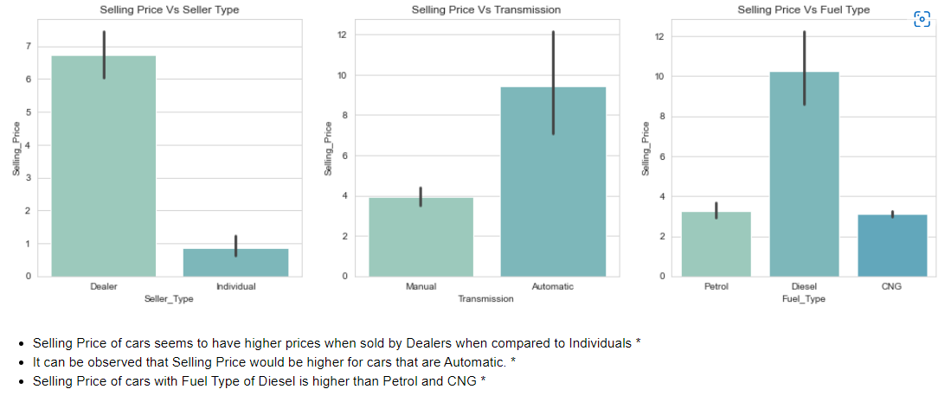

Slide 5
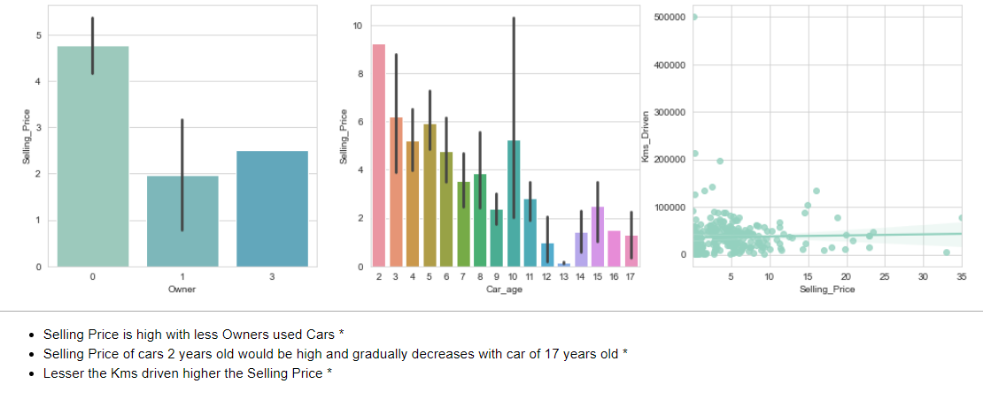

Slide 6
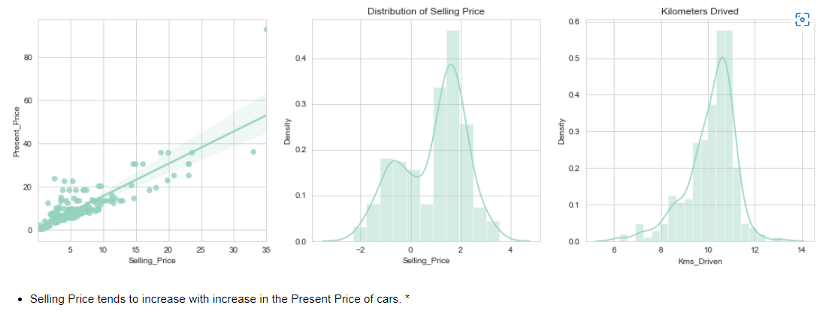

Slide 7
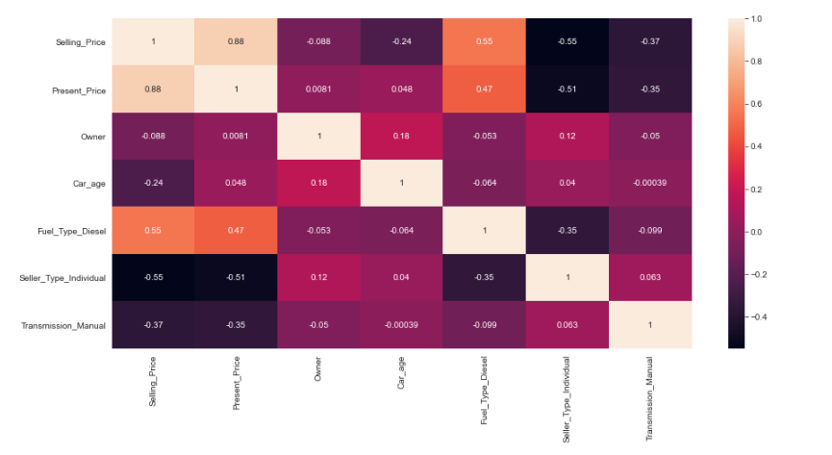

Slide 8
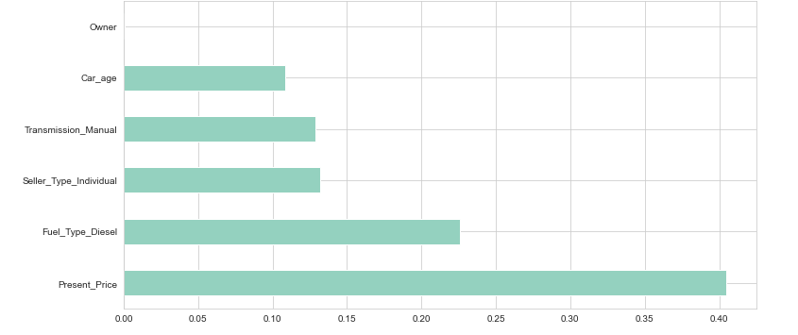

Slide 9
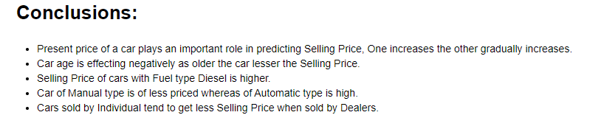

Slide 10
Thank you

